Slide 1
Setting IE Home Page and Starting IE after User Logins Using Kaseya
Developed By: Paola Nunez
Advisor : Dr. S. Masoud Sadjadi
School of Computing and Information Sciences
Florida International University
pnune005@fiu.edu
http://www.cs.fiu.edu/~sadjadi/

Slide 2
Agenda
Problem and Motivation
Solution
Behind the Scene
Customizing the Solution
Disclaimer
Progress Report

Slide 3

Problem and Motivation:
A company is trying to connect all office locations by installing a whole new intranet system
The system will work as a social media network within the company, where employees will be able to update project status, announce important news etc.
The operations officers have asked the IT department to have Internet Explorer open automatically to the new intranet site every time a user logs into their workstation

Slide 4
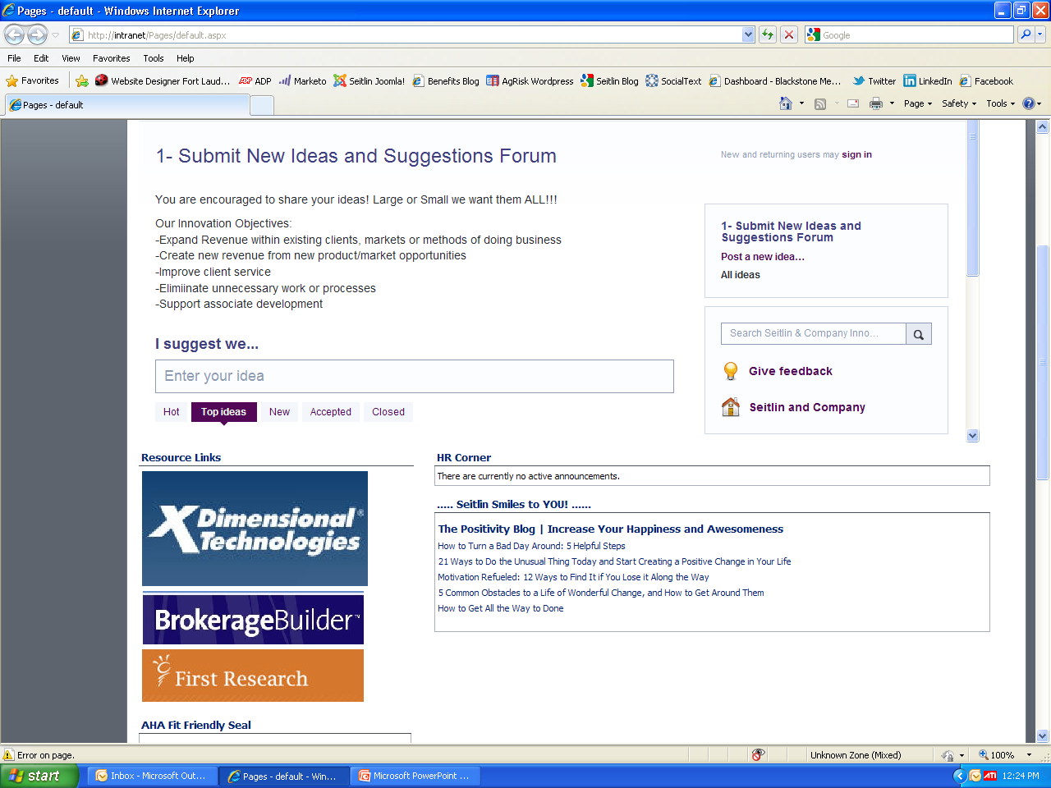
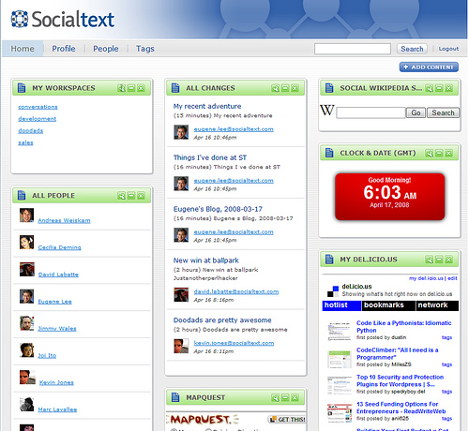
Fig 2.1

Slide 5
Solution
Using Kaseya, I will create a agent procedure that will open Internet Explorer with the new intranet web site as it’s default page, every time a user logs on into their work station

Slide 6
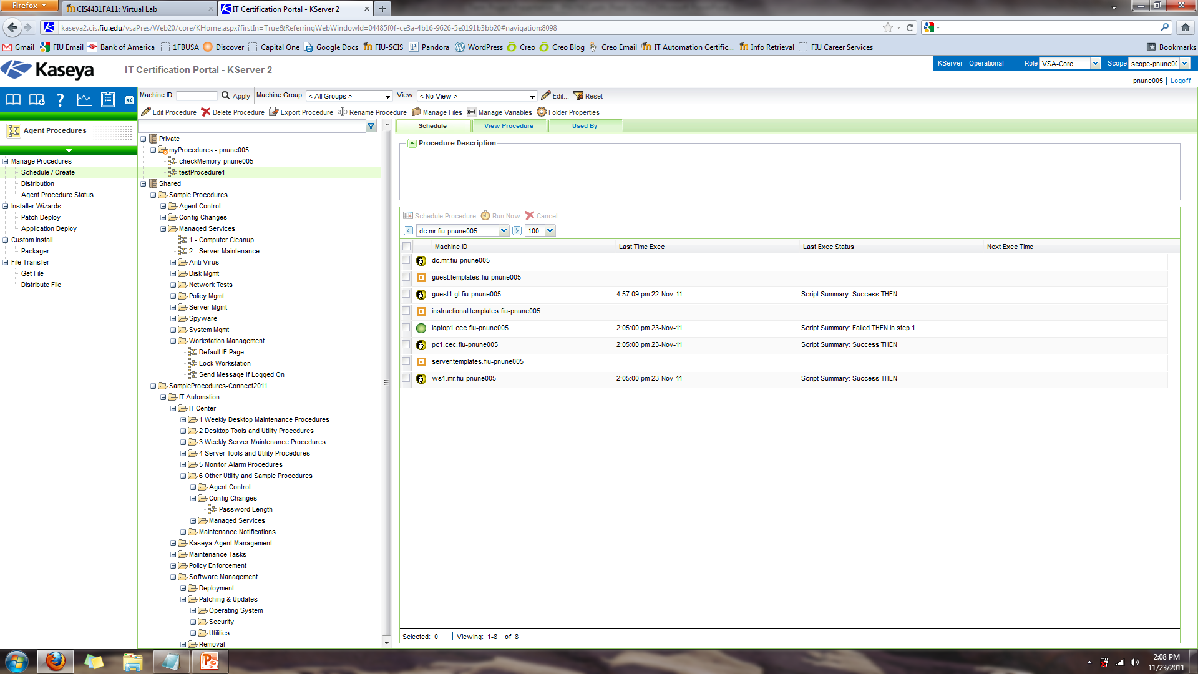
Fig 2.2
1
2
4
3

Slide 7
Behind the Scene
By adding the programs to the Run keys in the Registry
You can start a programs from executing at boot up by adding them to the run Keys in the Registry
  The script goes to the Run Key
    HKEY_LOCAL_MACHINE\SOFTWARE\Microsoft\Windows \CurrentVersion\Run
  As the value data I entered the path to the executable file for Internet Explorer
    C:\Program Files\Internet Explorer\iexplorer.exe

Slide 8
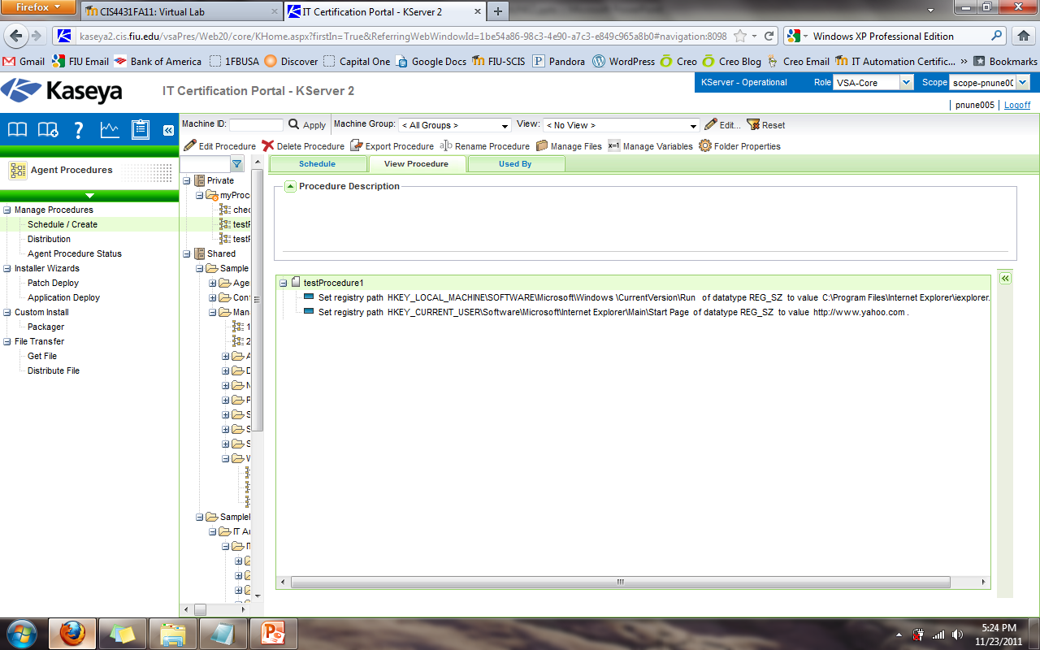
Fig 2.3

Slide 9
Customizing the Solution
Make Internet Explorer the default internet browser
Create an alert so the IT department knows whenever an user changes their default internet browser and default home page

Slide 10
Disclaimer
Has only been tested on Windows XP Pro
If Internet Explorer executable file it’s expected location then agent procedure will not work
  C:\Program Files\Internet Explorer\iexplorer.exe
…

Slide 11
Progress Report
Created script to open Internet Explorer whenever the user logs on, and sets the home page to the new intranet site
Currently testing on different computers
Find why the agent does not work on all workstations
Create a script to make Internet Explorer the default internet browser

